Slide 1
Assignment 11 & 12: Charts
DSC640-T301 Data Presentation and Visualization
Date:2/19/2023
By: Joshua Greenert

Slide 2
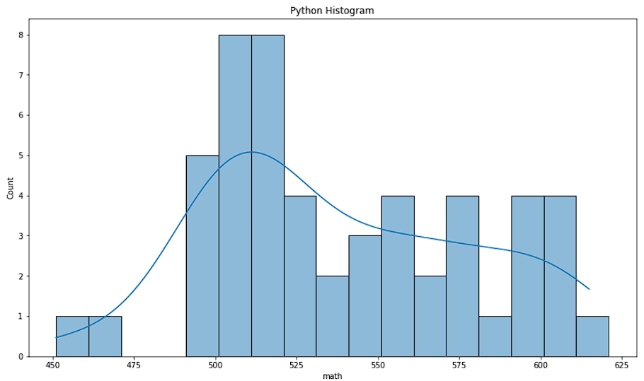
Python Charts

Slide 3
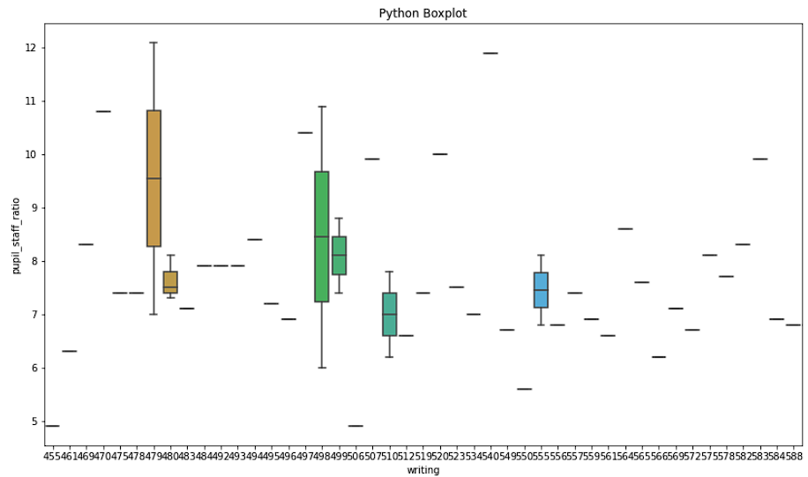
Python Charts

Slide 4
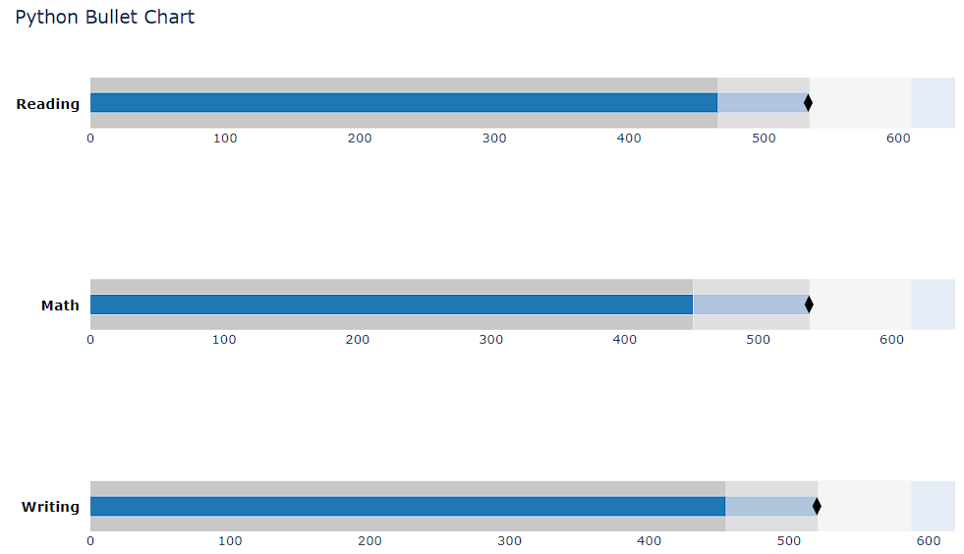
Python Charts

Slide 5
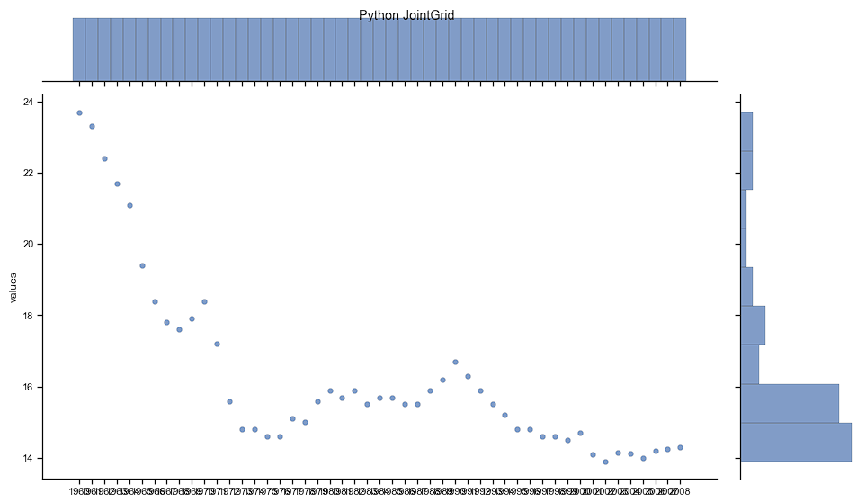
Python Charts

Slide 6
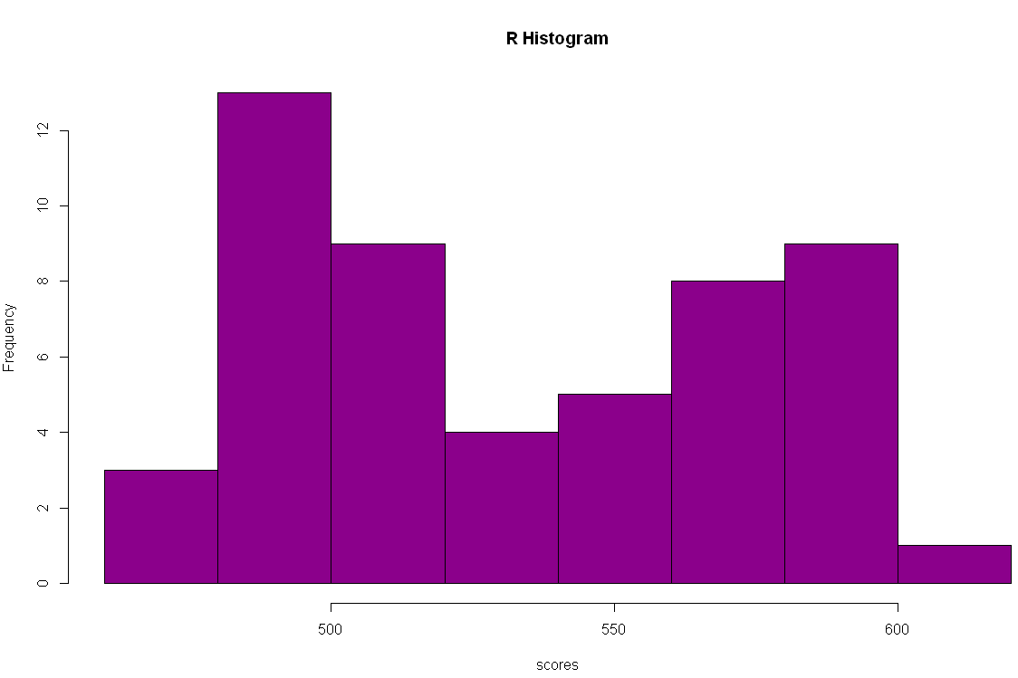
R Charts

Slide 7
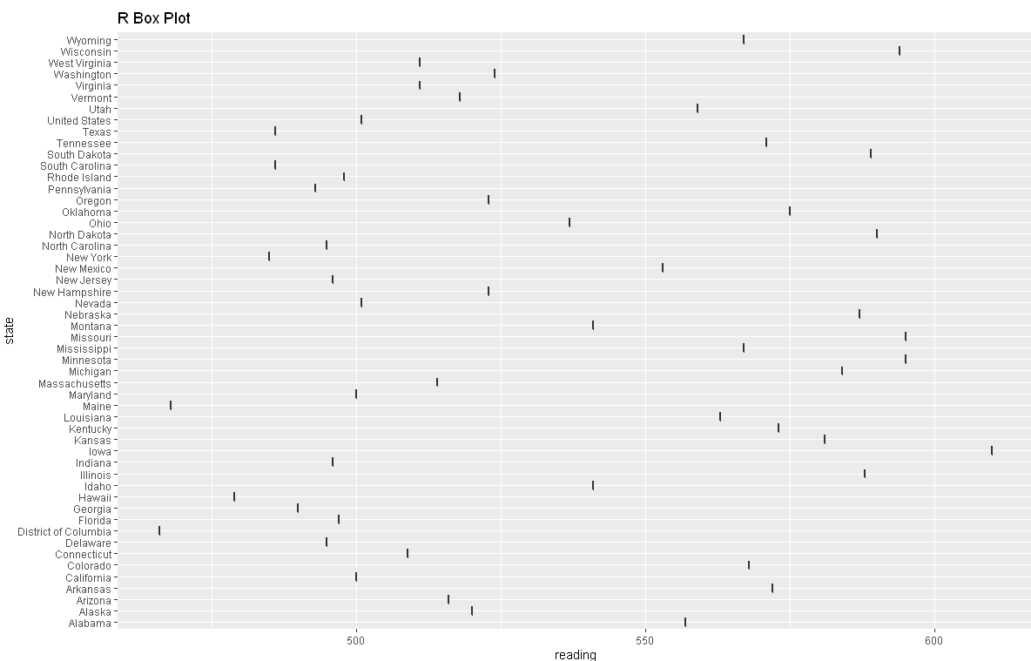
R Charts

Slide 8
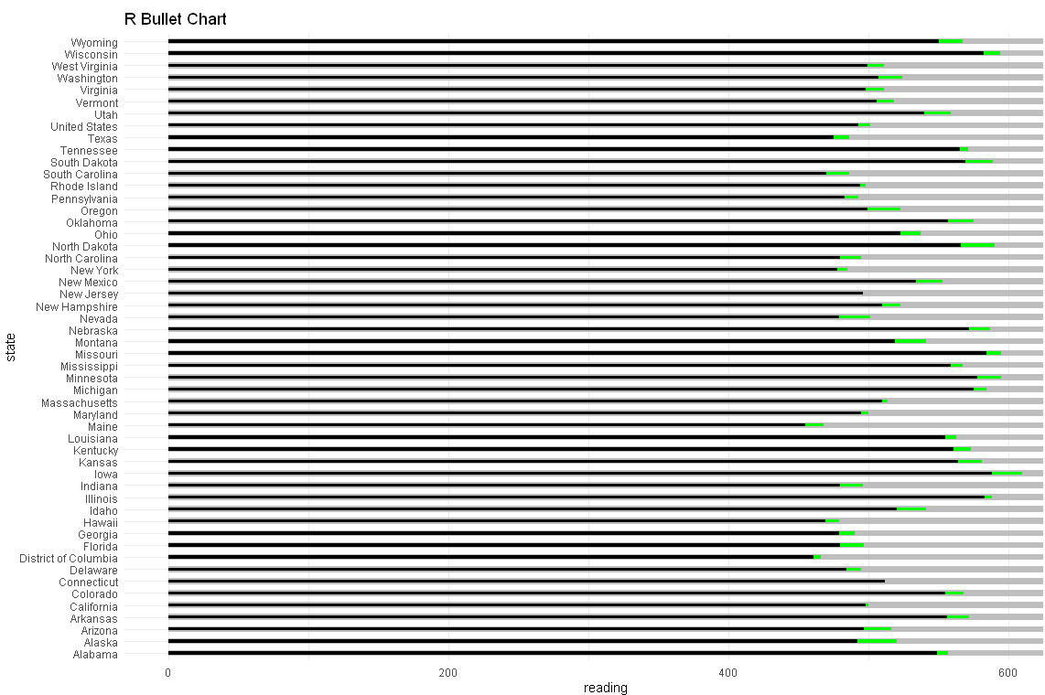
R Charts

Slide 9
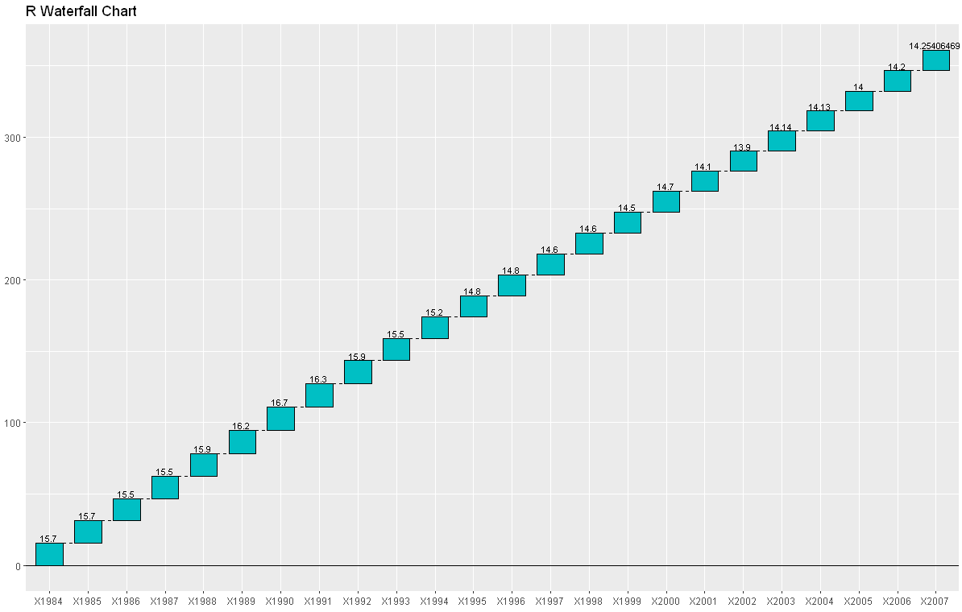
R Charts

Slide 10
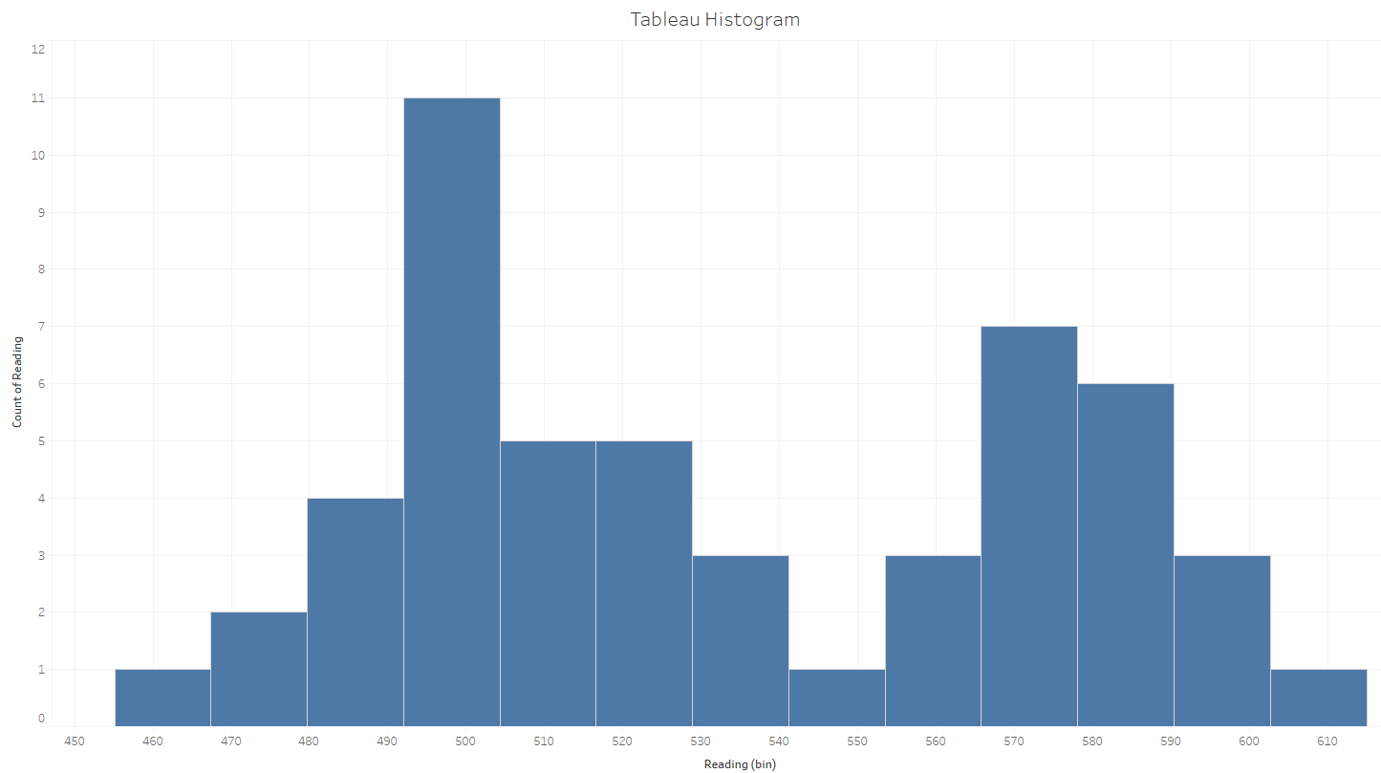
Tableau Charts

Slide 11
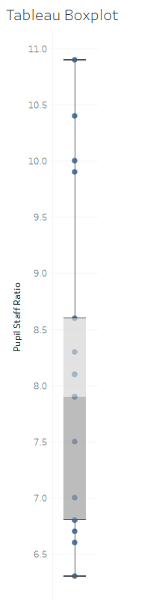
Tableau Charts

Slide 12
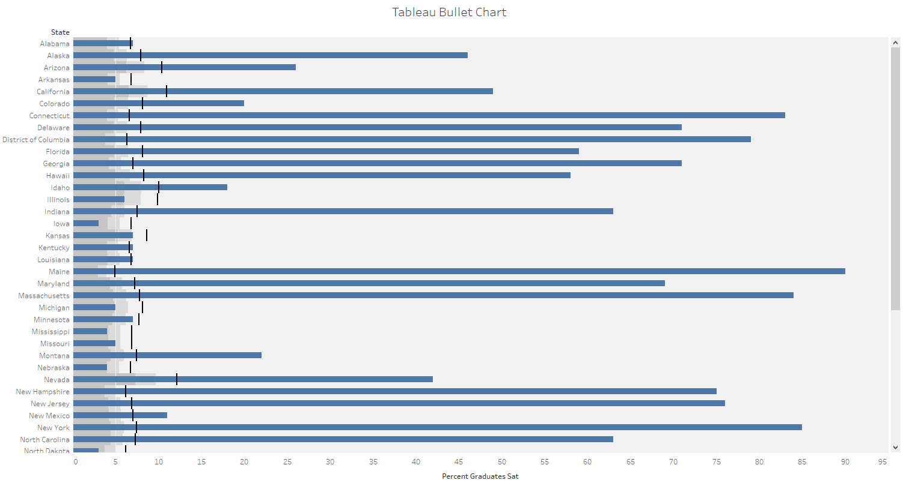
Tableau Charts

Slide 13
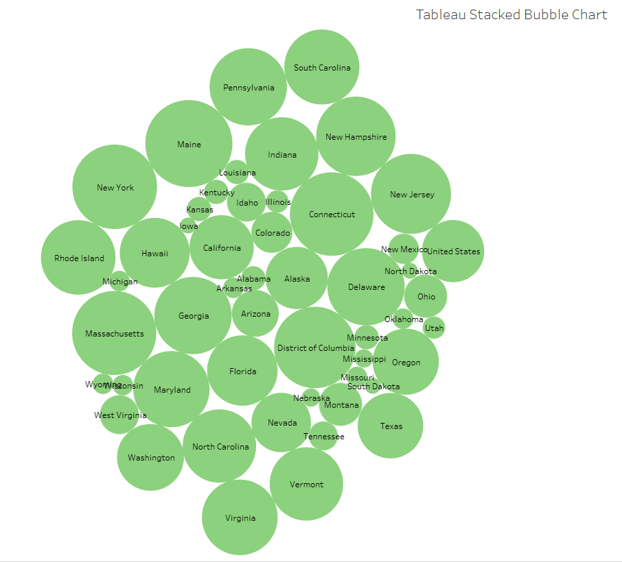
Tableau Charts

